Slide 1

W4111 – 02: Introduction to Databases
Lecture 1: Introduction, Course Overview, Core Concepts
Donald F. Ferguson dff9@Columbia.edu
TRANSCENDING DISCIPLINES, TRANSFORMING LIVES

Slide 2
Lecture Format
Unfortunately, the first couple of lectures’ content will jump back and forth between:
PowerPoint slides
Jupyter Notebooks
I am accommodating people who watch the recorded lecture videos.
The recording format contains a a closeup window of the slides, if I use the podium computer/slides.
The Jupyter notebook does not appear in the closeup window if I use my laptop.
I cannot run the Jupyter notebook on the podium computer because I have installed software for the course on my laptop.
The notebook and installed code allow me to run sample code and queries.
You will get access to slides, Jupyter notebooks and lecture recordings.
We will try/pilot online systems this semester, which hopefully will simplify lecture material/format.
2 | W4111_02_S20: Introduction to Databases -- Lecture 1

Slide 3
Switch to Notebook
3 | W4111_02_S20: Introduction to Databases -- Lecture 1

Slide 4
Chapter 1: Introduction

Slide 5
Outline
Database-System Applications
Purpose of Database Systems
View of Data
Database Languages
Database Design
Database Engine
Database Architecture
Database Users and Administrators
History of Database Systems

Slide 6
Database-System Applications
DBMS contains information about a particular enterprise
Collection of interrelated data
Set of programs to access the data
An environment that is both convenient and efficient to use
Database systems are used to manage collections of data that are:
Highly valuable
Relatively large
Accessed by multiple users and applications, often at the same time.
A modern database system is a complex software system whose task is to manage a large, complex collection of data.
Databases touch all aspects of our lives
Notes:
6

Slide 7
Database Applications Examples
Enterprise Information
Sales: customers, products, purchases
Accounting: payments, receipts, assets
Human Resources: Information about employees, salaries, payroll taxes.
Manufacturing: management of production, inventory, orders, supply chain.
Banking and finance
customer information, accounts, loans, and banking transactions.
Credit card transactions
Finance: sales and purchases of financial instruments (e.g., stocks and bonds; storing real-time market data
Universities: registration, grades
Notes:
7

Slide 8
Database Applications Examples (Cont.)
Airlines: reservations, schedules
Telecommunication: records of calls, texts, and data usage, generating monthly bills, maintaining balances on prepaid calling cards
Web-based services
Online retailers: order tracking, customized recommendations
Online advertisements
Document databases
Navigation systems: For maintaining the locations of varies places of interest along with the exact routes of roads, train systems, buses, etc.
Notes:
8

Slide 9
Purpose of Database Systems
In the early days, database applications were built directly on top of file systems, which leads to:
Data redundancy and inconsistency: data is stored in multiple file formats resulting induplication of information in different files
Difficulty in accessing data
Need to write a new program to carry out each new task
Data isolation
Multiple files and formats
Integrity problems
Integrity constraints (e.g., account balance > 0) become “buried” in program code rather than being stated explicitly
Hard to add new constraints or change existing ones
Notes:
9

Slide 10
Purpose of Database Systems (Cont.)
Atomicity of updates
Failures may leave database in an inconsistent state with partial updates carried out
Example: Transfer of funds from one account to another should either complete or not happen at all
Concurrent access by multiple users
Concurrent access needed for performance
Uncontrolled concurrent accesses can lead to inconsistencies
Ex: Two people reading a balance (say 100) and updating it by withdrawing money (say 50 each) at the same time
Security problems
Hard to provide user access to some, but not all, data
Database systems offer solutions to all the above problems
Notes:
10

Slide 11
University Database Example
In this text we will be using a university database to illustrate all the concepts
Data consists of information about:
Students
Instructors
Classes
Application program examples:
Add new students, instructors, and courses
Register students for courses, and generate class rosters
Assign grades to students, compute grade point averages (GPA) and generate transcripts
Notes:
11

Slide 12
View of Data
A database system is a collection of interrelated data and a set of programs that allow users to access and modify these data.
A major purpose of a database system is to provide users with an abstract view of the data.
Data models
A collection of conceptual tools for describing data, data relationships, data semantics, and consistency constraints.
Data abstraction
Hide the complexity of data structures to represent data in the database from users through several levels of data abstraction.
Notes:
12

Slide 13
Data Models
A collection of tools for describing
Data
Data relationships
Data semantics
Data constraints
Relational model
Entity-Relationship data model (mainly for database design)
Object-based data models (Object-oriented and Object-relational)
Semi-structured data model (XML)
Other older models:
Network model
Hierarchical model
Notes:
13

Slide 14
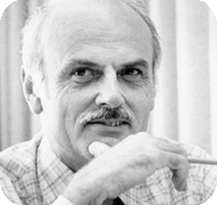

Relational Model
All the data is stored in various tables.
Example of tabular data in the relational model
Columns
Ted Codd Turing Award 1981
Rows
Notes:
14

Slide 15
A Sample Relational Database
Notes:
15

Slide 16
Levels of Abstraction
Physical level: describes how a record (e.g., instructor) is stored.
Logical level: describes data stored in database, and the relationships among the data.
type instructor = record
ID : string; name : string; dept_name : string; salary : integer;
end;
View level: application programs hide details of data types. Views can also hide information (such as an employee’s salary) for security purposes.
Notes:
16

Slide 17
View of Data
An architecture for a database system
Notes:
17

Slide 18
Instances and Schemas
Similar to types and variables in programming languages
Logical Schema – the overall logical structure of the database
Example: The database consists of information about a set of customers and accounts in a bank and the relationship between them
Analogous to type information of a variable in a program
Physical schema – the overall physical structure of the database
Instance – the actual content of the database at a particular point in time
Analogous to the value of a variable
Notes:
18

Slide 19
Physical Data Independence
Physical Data Independence – the ability to modify the physical schema without changing the logical schema
Applications depend on the logical schema
In general, the interfaces between the various levels and components should be well defined so that changes in some parts do not seriously influence others.
Notes:
19

Slide 20
Data Definition Language (DDL)
Specification notation for defining the database schema
Example: create table instructor ( ID char(5), name varchar(20), dept_name varchar(20), salary numeric(8,2))
DDL compiler generates a set of table templates stored in a data dictionary
Data dictionary contains metadata (i.e., data about data)
Database schema
Integrity constraints
Primary key (ID uniquely identifies instructors)
Authorization
Who can access what
Notes:
20

Slide 21
Data Manipulation Language (DML)
Language for accessing and updating the data organized by the appropriate data model
DML also known as query language
Two classes of languages
Pure – used for proving properties about computational power and for optimization
Relational Algebra
Tuple relational calculus
Domain relational calculus
Commercial – used in commercial systems
SQL is the most widely used commercial language
Notes:
21

Slide 22
Data Manipulation Language (Cont.)
There are basically two types of data-manipulation language
Procedural DML -- require a user to specify what data are needed and how to get those data.
Declarative DML -- require a user to specify what data are needed without specifying how to get those data.
Declarative DMLs are usually easier to learn and use than are procedural DMLs.
Declarative DMLs are also referred to as non-procedural DMLs
The portion of a DML that involves information retrieval is called a query language.
Notes:
22

Slide 23
SQL Query Language
SQL query language is nonprocedural. A query takes as input several tables (possibly only one) and always returns a single table.
Example to find all instructors in Comp. Sci. dept
select name from instructor where dept_name = 'Comp. Sci.'
SQL is NOT a Turing machine equivalent language
To be able to compute complex functions SQL is usually embedded in some higher-level language
Application programs generally access databases through one of
Language extensions to allow embedded SQL
Application program interface (e.g., ODBC/JDBC) which allow SQL queries to be sent to a database
Notes:
23

Slide 24
Database Access from Application Program
Non-procedural query languages such as SQL are not as powerful as a universal Turing machine.
SQL does not support actions such as input from users, output to displays, or communication over the network.
Such computations and actions must be written in a host language, such as C/C++, Java or Python, with embedded SQL queries that access the data in the database.
Application programs -- are programs that are used to interact with the database in this fashion.
Notes:
24

Slide 25
Database Design
The process of designing the general structure of the database:
Logical Design – Deciding on the database schema. Database design requires that we find a “good” collection of relation schemas.
Business decision – What attributes should we record in the database?
Computer Science decision – What relation schemas should we have and how should the attributes be distributed among the various relation schemas?
Physical Design – Deciding on the physical layout of the database
Notes:
25

Slide 26
Database Engine
A database system is partitioned into modules that deal with each of the responsibilities of the overall system.
The functional components of a database system can be divided into
The storage manager,
The query processor component,
The transaction management component.
Notes:
26

Slide 27
Storage Manager
A program module that provides the interface between the low-level data stored in the database and the application programs and queries submitted to the system.
The storage manager is responsible to the following tasks:
Interaction with the OS file manager
Efficient storing, retrieving and updating of data\
The storage manager components include:
Authorization and integrity manager
Transaction manager
File manager
Buffer manager
Notes:
27

Slide 28
Storage Manager (Cont.)
The storage manager implements several data structures as part of the physical system implementation:
Data files -- store the database itself
Data dictionary -- stores metadata about the structure of the database, in particular the schema of the database.
Indices -- can provide fast access to data items. A database index provides pointers to those data items that hold a particular value.
Notes:
28

Slide 29
Query Processor
The query processor components include:
DDL interpreter -- interprets DDL statements and records the definitions in the data dictionary.
DML compiler -- translates DML statements in a query language into an evaluation plan consisting of low-level instructions that the query evaluation engine understands.
The DML compiler performs query optimization; that is, it picks the lowest cost evaluation plan from among the various alternatives.
Query evaluation engine -- executes low-level instructions generated by the DML compiler.
Notes:
29

Slide 30
Query Processing
1. Parsing and translation
2. Optimization
3. Evaluation
Notes:
30

Slide 31
Transaction Management
A transaction is a collection of operations that performs a single logical function in a database application
Transaction-management component ensures that the database remains in a consistent (correct) state despite system failures (e.g., power failures and operating system crashes) and transaction failures.
Concurrency-control manager controls the interaction among the concurrent transactions, to ensure the consistency of the database.
Notes:
31

Slide 32
Database Architecture
Centralized databases
One to a few cores, shared memory
Client-server,
One server machine executes work on behalf of multiple client machines.
Parallel databases
Many core shared memory
Shared disk
Shared nothing
Distributed databases
Geographical distribution
Schema/data heterogeneity
Notes:
32

Slide 33
Database Applications
Database applications are usually partitioned into two or three parts
Two-tier architecture -- the application resides at the client machine, where it invokes database system functionality at the server machine
Three-tier architecture -- the client machine acts as a front end and does not contain any direct database calls.
The client end communicates with an application server, usually through a forms interface.
The application server in turn communicates with a database system to access data.
Notes:
33

Slide 34
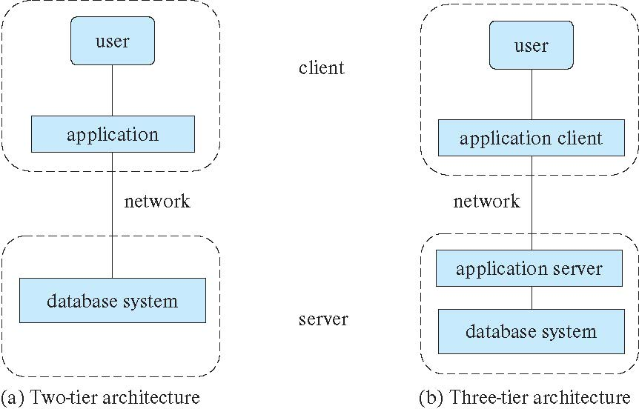
Two-tier and three-tier architectures
Notes:
34

Slide 35
Database Users
There are four different types of database-system users
Naive users -- unsophisticated users who interact with the system by invoking one of the application programs that have been written previously.
Application programmers -- are computer professionals who write application programs.
Sophisticated users -- interact with the system without writing programs
using a database query language or by
using tools such as data analysis software.
Specialized users --write specialized database applications that do not fit into the traditional data-processing framework. For example, CAD, graphic data, audio, video.
Notes:
35

Slide 36
Database Administrator
A person who has central control over the system is called a database administrator (DBA), whose functions are:
Schema definition
Storage structure and access-method definition
Schema and physical-organization modification
Granting of authorization for data access
Routine maintenance
Periodically backing up the database
Ensuring that enough free disk space is available for normal operations, and upgrading disk space as required
Monitoring jobs running on the database and ensuring that performance is not degraded by very expensive tasks submitted by some users
Notes:
36

Slide 37
History of Database Systems
1950s and early 1960s:
Data processing using magnetic tapes for storage
Tapes provided only sequential access
Punched cards for input
Late 1960s and 1970s:
Hard disks allowed direct access to data
Network and hierarchical data models in widespread use
Ted Codd defines the relational data model
Would win the ACM Turing Award for this work
IBM Research begins System R prototype
UC Berkeley (Michael Stonebraker) begins Ingres prototype
Oracle releases first commercial relational database
High-performance (for the era) transaction processing
Notes:
37

Slide 38
History of Database Systems (Cont.)
1980s:
Research relational prototypes evolve into commercial systems
SQL becomes industrial standard
Parallel and distributed database systems
Wisconsin, IBM, Teradata
Object-oriented database systems
1990s:
Large decision support and data-mining applications
Large multi-terabyte data warehouses
Emergence of Web commerce
Notes:
38

Slide 39
History of Database Systems (Cont.)
2000s
Big data storage systems
Google BigTable, Yahoo PNuts, Amazon,
“NoSQL” systems.
Big data analysis: beyond SQL
Map reduce and friends
2010s
SQL reloaded
SQL front end to Map Reduce systems
Massively parallel database systems
Multi-core main-memory databases
Notes:
39

Slide 40
End of Chapter 1
Notes:
40

Slide 41
Lecture Overview
Introduction and course overview
Instructor
Course material
Tracks
Lecture schedule
Assignments, exams and grading
Logistics
Motivating Examples
Core concepts
Database-System Applications
Purpose of Database Systems
View of Data
Database Languages
Database Design
Database Engine
Database Architecture
Database Users and Administrators
History of Database Systems
41 | W4111_02_S20: Introduction to Databases -- Lecture 1

Slide 42

Introduction and Course Overview
42 | W4111_02_S20: Introduction to Databases -- Lecture 1

Slide 43
Instructor
Contact information:
Email: dff9@columbia.edu
Slack: https://dff-columbia.slack.com/
Donald F. Ferguson
Ansys, Inc.: Senior Technical Fellow, Chief Software Architect.
Adjunct Professor, Dept. of Computer Science.
Academic experience
Ph.D. in Computer Science, Columbia University, 1989
Joined Columbia as full time _Professor of Professional Practice_, 01-Jan-2018.
Transitioned back to Adjunct Professor, 01-Jan-2019.
12 semesters as an adjunct professor teaching
E6998: Topics in Computer Science: Cloud Computing, Web and Internet Application Development, Web Application Servers and Applications, Microservices
W4111 - Introduction to Databases (5 semesters(
Professor of Professional Practice in Computer Science, January 2018
E1006 - Introduction to Computing for Engineers and Applied Scientists using Python
W4111 - Introduction to Databases
E6156 - Topics in SW Engineering: Microservices and Cloud Applications
43 | W4111_02_S20: Introduction to Databases -- Lecture 1

Slide 44
Instructor
30 years industry experience
IBM Fellow, Chief Architect for [IBM Software Group](https://en.wikipedia.org/wiki/IBM_Software_Group_(SWG)
Microsoft Technical Fellow
Executive Vice President, Chief Technology Officer, CA Technologies
Vice President, CTO, Senior Fellow, Dell Software Group
Co-Founder and CTO, Seeka TV
Senior Technical Fellow, Chief SW Architect, Ansys, Inc.
Publications
Approximately 60 technical publications.
Authored, co-authored several standards in web applications and web services.
Web Services Platform Architecture: SOAP, WSDL, WS-Policy, WS-Addressing, WS-BPEL, WS-Reliable Messaging, and More, ISBN-13: 978-0131488748, 2005, Pearson Education.
12 patents.
Personal and hobbies
Two amazing daughters (One is Barnard student. One is a senior in high school)
Interested in languages. Speak Spanish reasonably well and trying to learn Arabic.
Black Belt in Kenpo Karate
Amateur astronomy
Road bicycling
Officer in the New York Guard
44 | W4111_02_S20: Introduction to Databases -- Lecture 1

Slide 45
Motivating Example(s)
45 | W4111_02_S20: Introduction to Databases -- Lecture 1

Slide 46
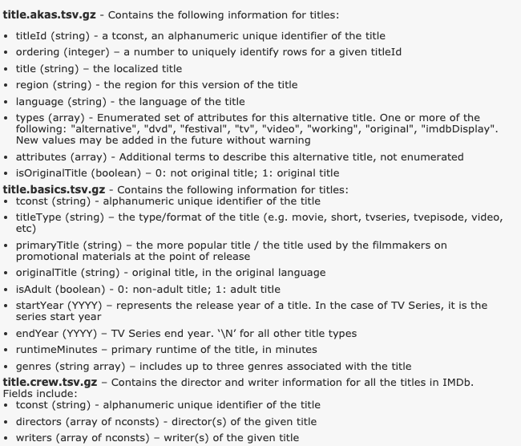
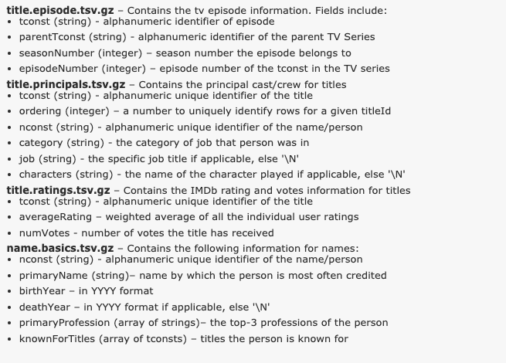
IMDB File Model
46 | W4111_02_S20: Introduction to Databases -- Lecture 1

Slide 47
Find Everyone who was a Principal with a Selected Principal
Find name_basics row using
name or
ID
Find all the pairings of the form
Title ID
Principal ID
For the search principal
For each pairing
Find all other principals in the movie
Find the matching title.
Find the person information.
Return the answer.
47 | W4111_02_S20: Introduction to Databases -- Lecture 1

Slide 48
Steps 1,2: Person → Linking Table → Title IDs
1.
2.
48 | W4111_02_S20: Introduction to Databases -- Lecture 1

Slide 49
Steps 3: For Each Title, Find the other Principals
For each title from 2:
Scan to find principals
3.
1.
2.
49 | W4111_02_S20: Introduction to Databases -- Lecture 1

Slide 50

Example I – IMDB
50 | W4111_02_S20: Introduction to Databases -- Lecture 1

Slide 51

IMDB
51 | W4111_02_S20: Introduction to Databases -- Lecture 1

Slide 52
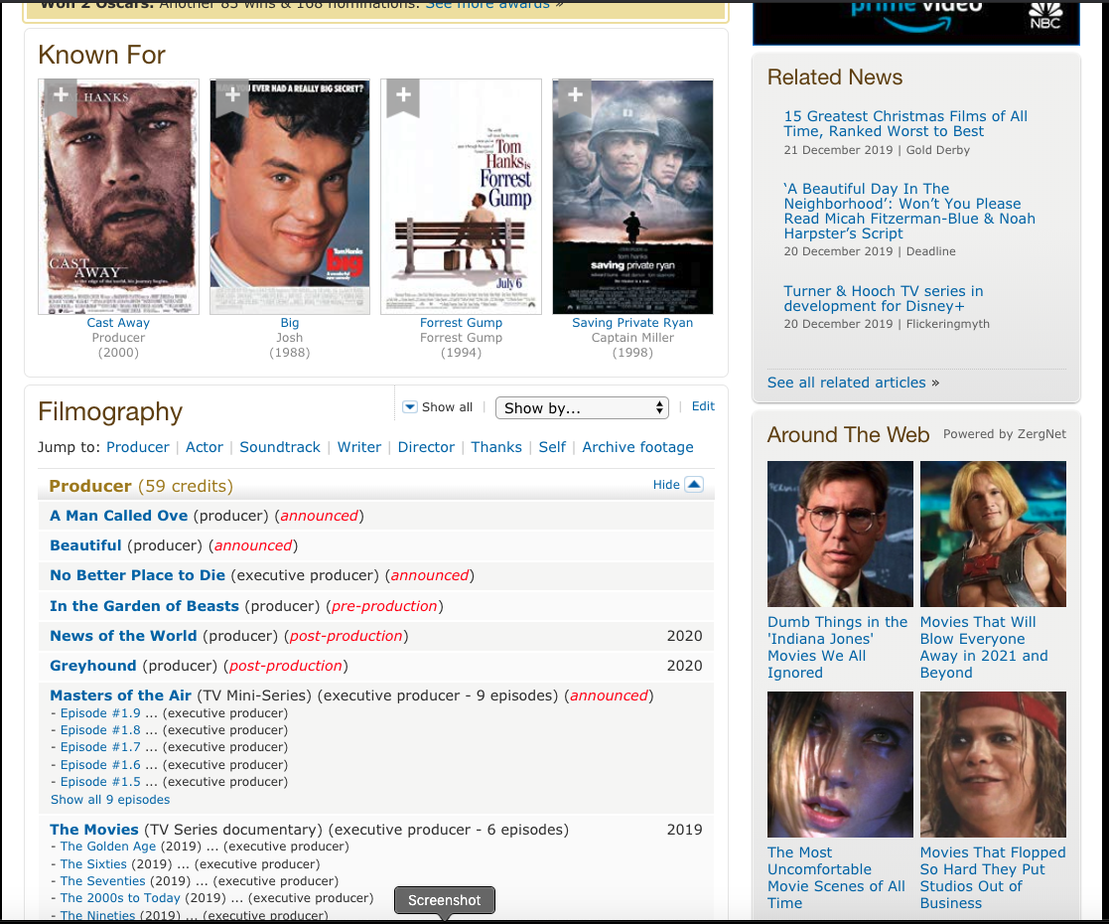
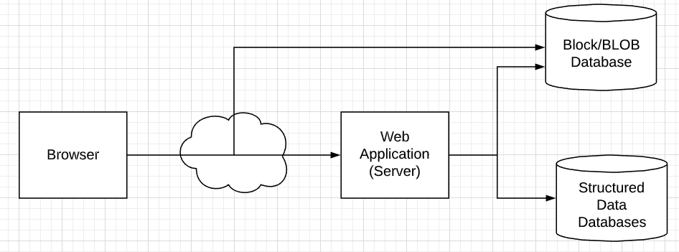
IMDB – Tom Hanks
There is a lot of stuff to understand.
There is a basic application structure
Logical 3-Tier Application
Real solution is staggering more complex.
Key concepts:
Two databases:
Block/BLOB for images, HTML, …
Structured data for info about people, movies, …
Interactive web application:
Implements code for requests.
Figuring out how to find data and assemble pages from sub-elements.
Let’s look at the structured data.
52 | W4111_02_S20: Introduction to Databases -- Lecture 1

Slide 53
IMDB – Tom Hanks
53 | W4111_02_S20: Introduction to Databases -- Lecture 1

Slide 54
Example II – NY Guard Application Processing
54 | W4111_02_S20: Introduction to Databases -- Lecture 1

Slide 55
Lecture Overview
Introduction and course overview
Instructor
Course material
Tracks
Lecture schedule
Assignments, exams and grading
Logistics
Motivating Examples
Core concepts
Database-System Applications
Purpose of Database Systems
View of Data
Database Languages
Database Design
Database Engine
Database Architecture
Database Users and Administrators
History of Database Systems
55 | W4111_02_S20: Introduction to Databases -- Lecture 1

Slide 56
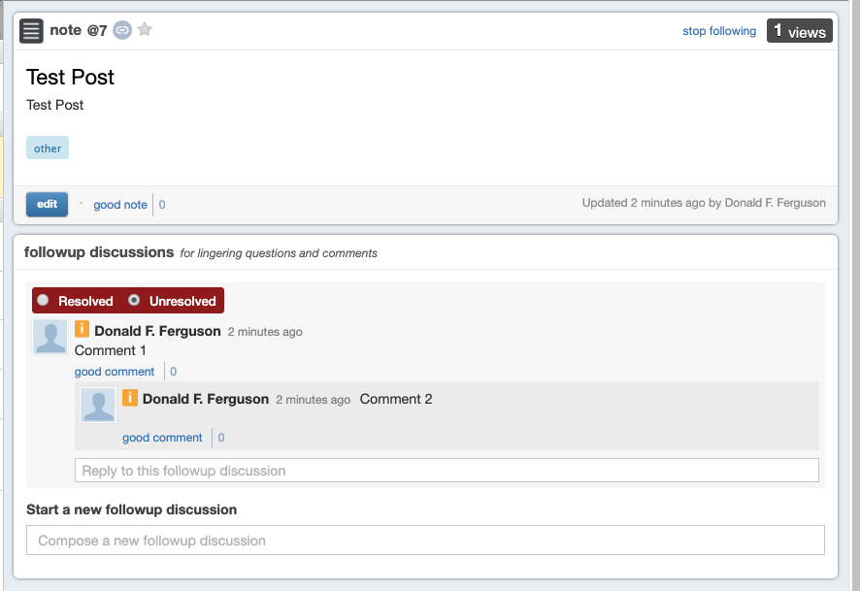
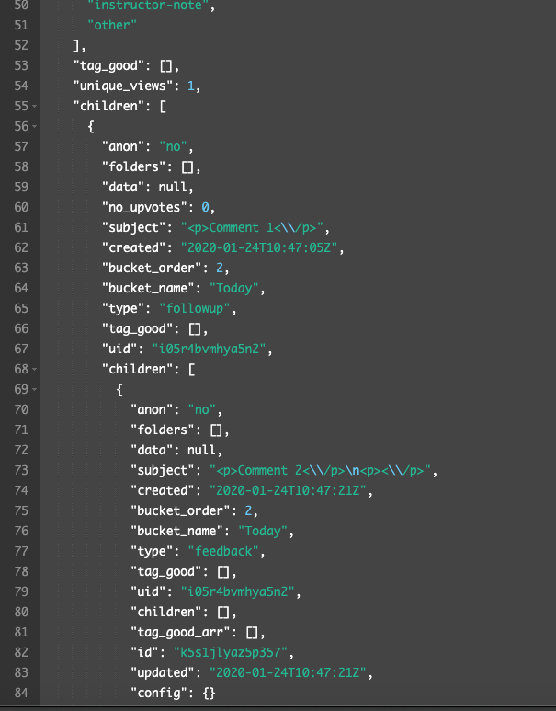
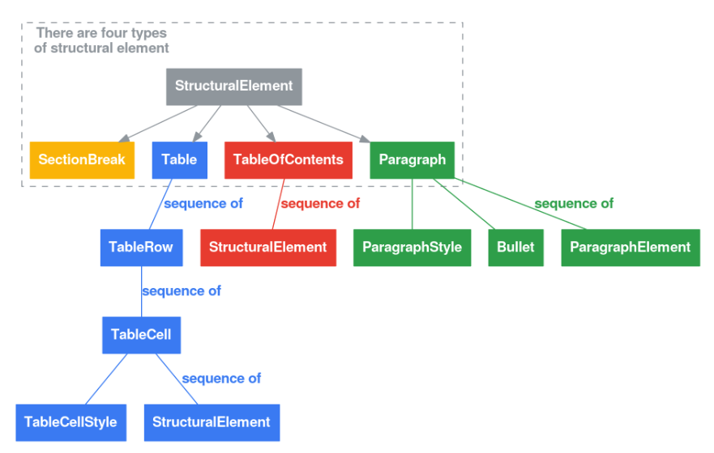
CouchDB Sample Data -- Semi-structured
Piazza Post
Piazza Post Data
Piazza Post Data
Documents are the classic example
Of semi-structures
Google Doc
Structures
56 | W4111_02_S20: Introduction to Databases -- Lecture 1

